Slide 1
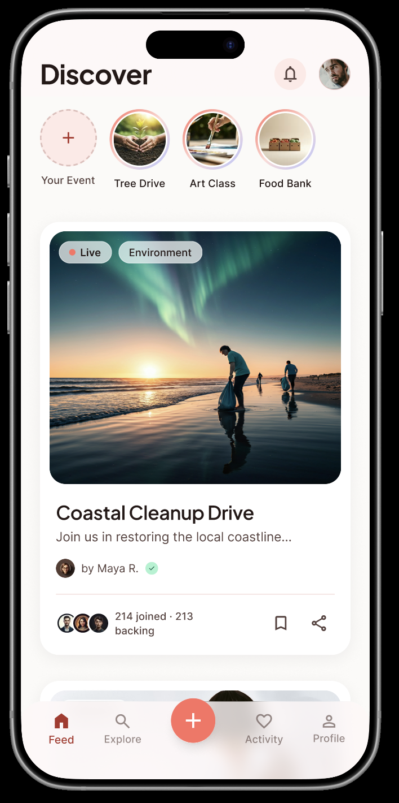
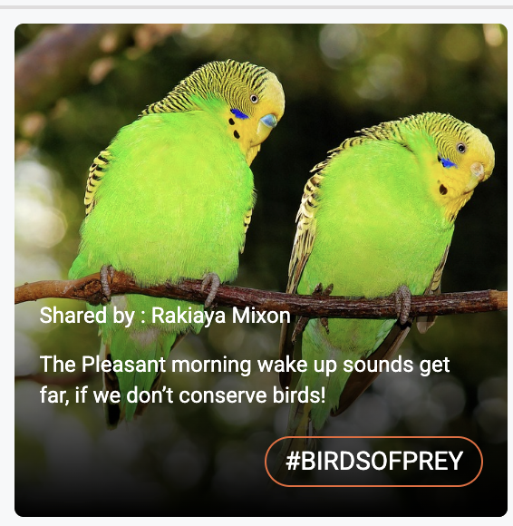
Hi Anish, below are my two change request with explanations. We can discuss if they work or they don’t. Thank You for your help.
#EVENTS, one of my branding goals for Charity Hub is to leverage #Events as our “Thing” and possibly even use it as a marketing slogan as a product differentiator. In our MMVP we used the Event Name overlaid on the feed content. Please see the #Birdsofprey. Can we mock up some feed content with this same overlay and see if it translate into a cleaner and newer design. The #Event name will carry from feed into Marquee Event Page. Does it add a connectivity or is it distracting? I won’t know if it has staying power until I see it across those two pages.
Below is the MMVP for your reference
MMVP: https://charityhubmmvp-402d1.firebaseapp.com/home

Slide 2
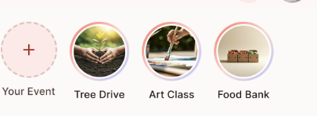
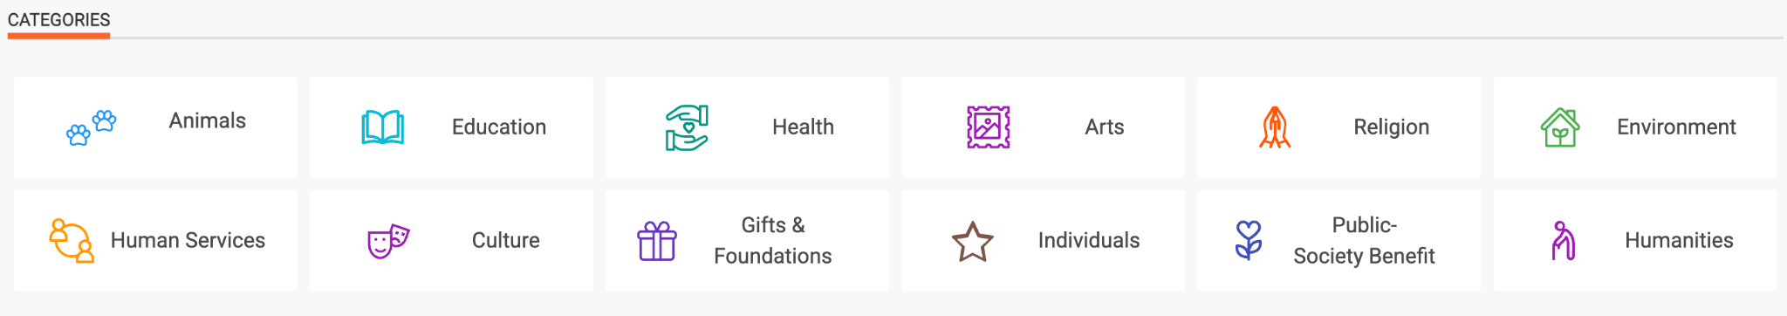
The Urban Legend is that Meta stole the stories feature from Snapchat because it was so successful but it also solved a huge instagram problem. People were carefully curating content for their individual pages. Instagram saw that users were setting up pictures but not finishing the post. Stories got users to post much more content because users weren’t as selective with how good the content looked.
Totally 100% dopamine crack for a user!! I love it!!!!!!
I think we have a real dopamine potential for our own unique “Inside Look” adaptation of stories. Instead of seeing all the content from one event per button, I would like to see “Category Buttons” up top. So the four circle buttons you have up top would scroll to include all the Categories below in circle form design. If a users interest is Art they would chose Art.
When a user clicks on say Art we start giving them the top liked picture from the top liked 100 Art events, just one picture, then the second liked picture from the top 100 events.
Categories keeps the Community Theme but also has more potential for users to “click into” a lot more events based on their category like. Each picture would fit the screen and have the #EventName. They will scroll and bounce in and out of #Events all day

